Slide 1
Colorectal Liver Metastases Recurrence Prediction from Clinical and CT Image Data
Group 6: Ju-Chun Huang, Xueke Jin, Yuxuan Shen, Wanzi Xiao
April 24th, 2023

Slide 2
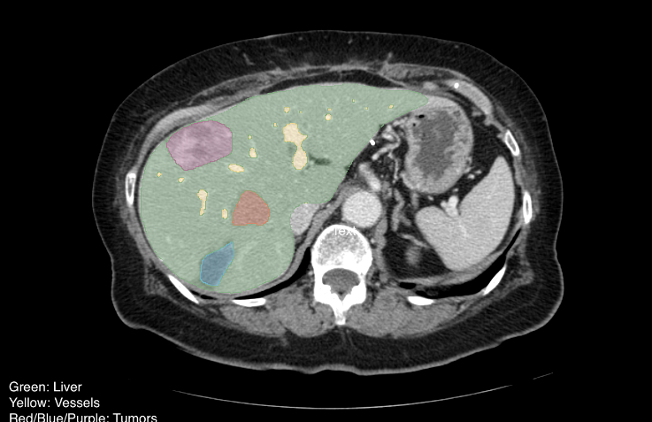
Introduction
Aim: Preoperative prediction of hepatic recurrence may inform therapeutic strategies at the time of initial resection of colorectal cancer.
Dataset: Preoperative CT and Recurrence for Patients Undergoing Resection of
Colorectal Liver Metastases (2023)
197 patients
Raw CT images (DICOM)
Segmentation images (DSOs)
Clinical data (CSV)
Method:
Support Vector Machine (SVM)
Random Forest
Convolutional Neural Network (CNN)
Simpson, A. L., Peoples, J., Creasy, J. M., Fichtinger, G., Gangai, N., Lasso, A., Keshava Murthy, K. N., Shia, J., D’Angelica, M. I., & Do, R. K. G. (2023). Preoperative CT and Recurrence for Patients Undergoing Resection of Colorectal Liver Metastases (Colorectal Liver Metastases) (Version 1) [Data set]. The Cancer Imaging Archive. https://doi.org/10.7937/QXK2-QG03

Slide 3
Methods : SVM
SVM: a supervised machine learning algorithm that is widely used for both classification and regression tasks
Reasons why we can choose SVM algorithm:
Binary Classification: well-suited for binary classification tasks.
Handling High-Dimensional Data: features relevant to predicting recurrence.
Regularization: prevent overfitting.
Steps:
Data Preprocessing:
a. Handle missing values
b. Feature scaling: Standardize the features on the same scale.
c. Feature engineering: choose features based on feature variance to improve the model's predictive performance
d. Data splitting: training and testing sets
Model
a. train_svm(X, y, epochs, learning_rate, C=1, threshold=0.5) : computes the linear output to obtain the predicted class labels
b. predict_svm(X, weights, bias, threshold=0.5): makes predictions on new input data and output predicted class labels
Evaluation
Accuracy, precision, recall, F1 score, specificity

Slide 4
Methods : Random Forest
Reason to Choose Random Forest:
Good at handling missing values and outliers by imputing the missing values or treating the outliers as a separate class, reducing the risk of overfitting.
Steps:
Data Preprocessing:
a. Handle missing values
b. Feature scaling: Standardize the features on the same scale
c. Feature engineering: choose features based on feature variance to improve the model's predictive performance
d. Data splitting: training and testing sets
2. Model:
a.random_forest(X_train, y_train, n_estimators, max_features, max_depth, min_samples_split): computes the linear output to obtain the predicted class labels
b. predict_rf(tree_ls, X_test): make predictions on new input data and output predicted class label
3. Evaluation:
Accuracy, precision, recall, F1 score, specificity

Slide 5
Methods: Convolutional Neural Network
Reason to CNN:
As a deep learning neural network, CNNs are particularly good at extracting more relevant features without the need for manual feature engineering from images, such as shape, size, texture, and location.They have a better performance at handling 3 dimensional CT images. Besides, CNNs are more powerful at learning complex and non-linear relationships between relationship between the image features and cancer recurrence. They can be trained on large datasets and then fine-tuned on smaller, more specific datasets.
Steps:
Data Preprocessing:
a. Image processing: convert dicom files from CT scanning into multiple layers of images for each patient.
b. Data augmentation: enrich the training datasets rotating, flipping and cropping the images.
c. Data splitting: training and testing sets
d. Data loading: split the data into batches for training
2. Model:
Aftering trying common CNN models such as ResNet and ConvNext, we chose VGG as our model. It’s a narrow but deep network
consists of multiple convolutional layers followed by max-pooling layers, with fully connected layers at the end for classification.
We then did ablations on model parameters, optimizers and learning rate to achieve better performance
3. Evaluate model:
Accuracy, Confusion matrix

Slide 6
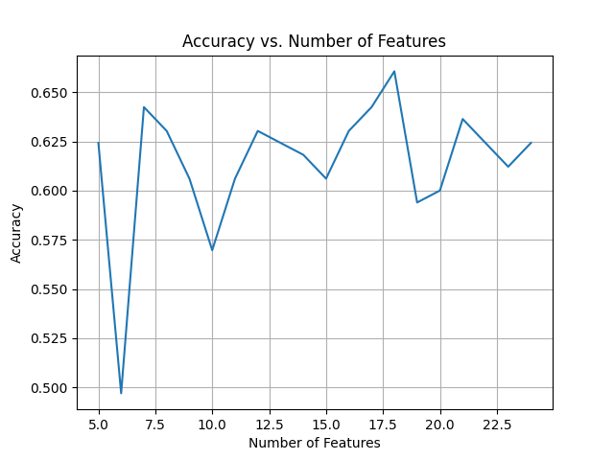
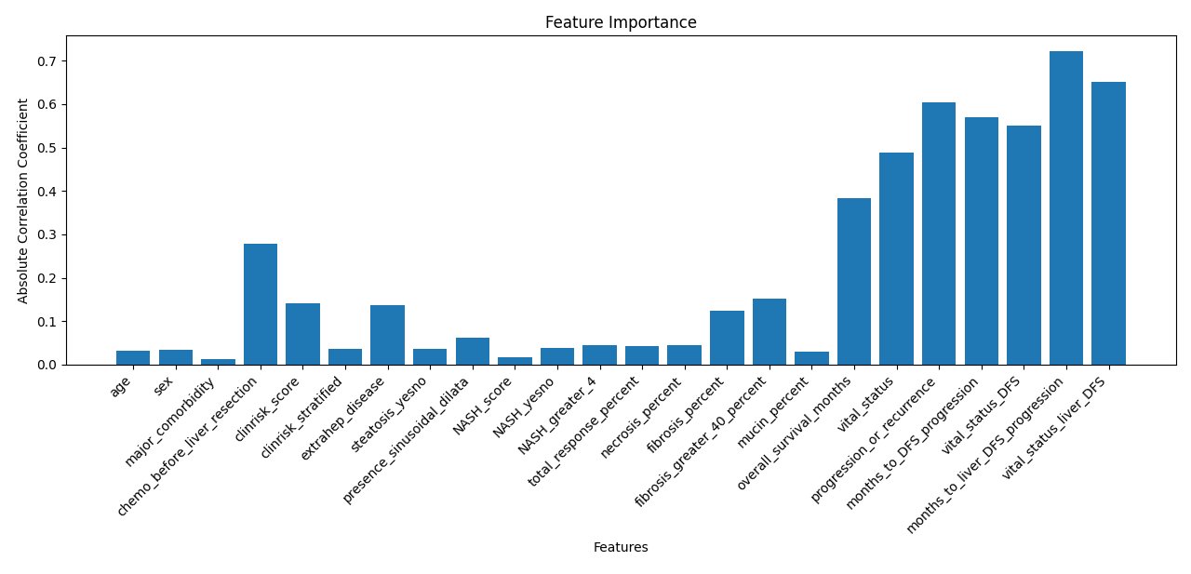
Results: SVM
k = 18 with the best performance
Highest Accuracy: 0.660
Selected Features with Highest Accuracy: ['clinrisk_stratified', 'NASH_yesno', 'total_response_percent', 'necrosis_percent', 'NASH_greater_4', 'presence_sinusoidal_dilata', 'fibrosis_percent', 'extrahep_disease', 'clinrisk_score', 'fibrosis_greater_40_percent', 'chemo_before_liver_resection', 'overall_survival_months', 'vital_status', 'vital_status_DFS', 'months_to_DFS_progression', 'progression_or_recurrence', 'vital_status_liver_DFS', 'months_to_liver_DFS_progression']

Slide 7
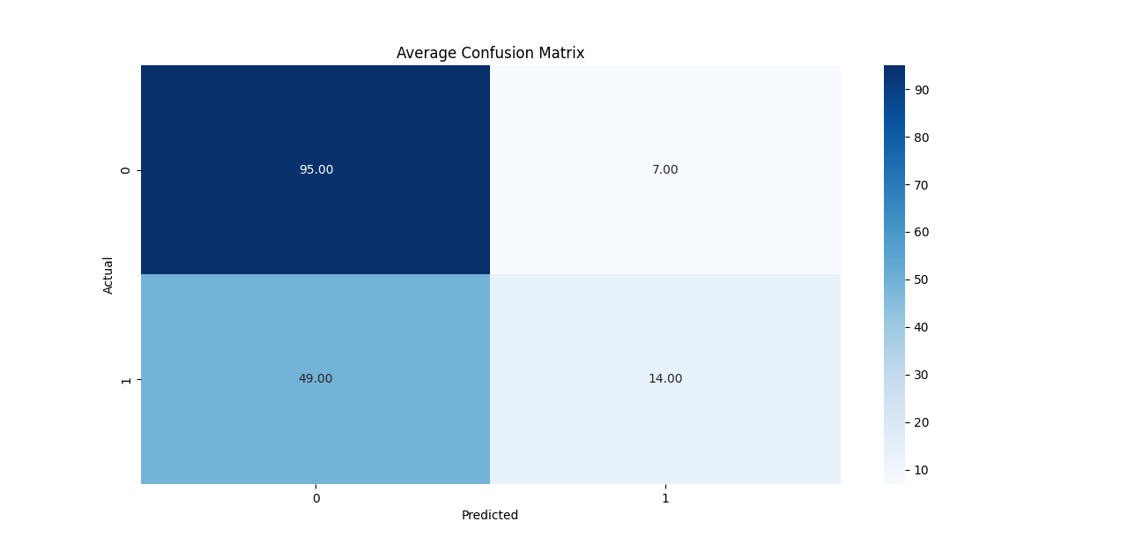
Results: SVM
Evaluation:
Accuracy: 66.1%
Precision: 66.7%
Recall (Sensitivity): 22.2%
F1-Score: 33.3%
Specificity: 93.1%
k=18 confusion matrix

Slide 8
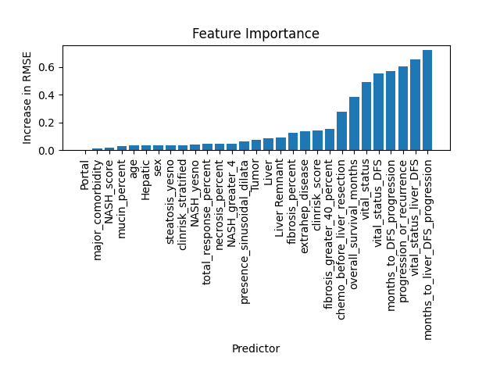
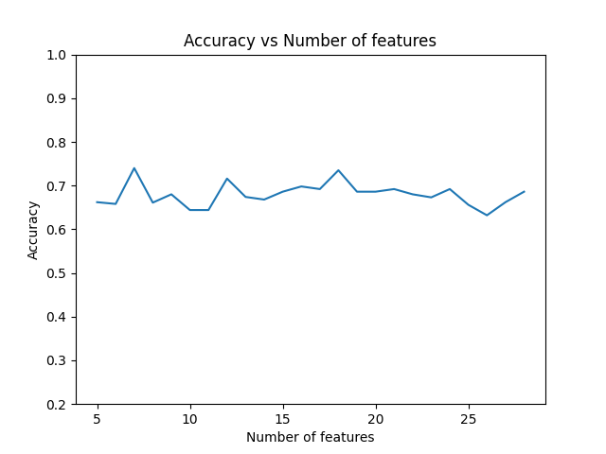
Results: Random Forest
k = 7 with the best performance
Highest Accuracy: 0.74

Slide 9
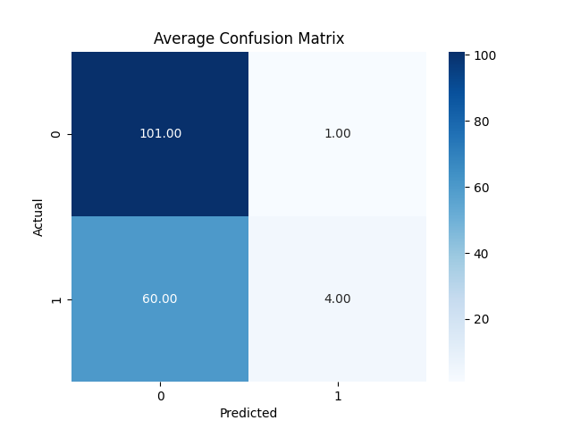
Results: Random Forest
Evaluation:
Accuracy: 63.01%
Precision: 80%
Recall (Sensitivity): 6.25%
F1-Score: 11.43%
Specificity: 99.02%

Slide 10
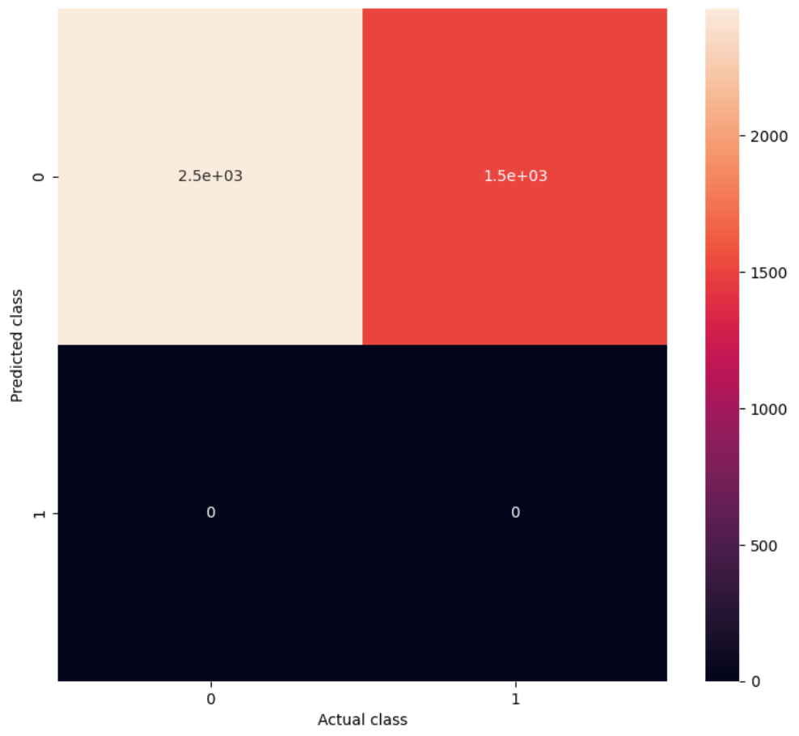
Results: CNN
Evaluation:
Accuracy: 61.89%
F1 score: 0.00%

Slide 11
Conclusion
Model | Accuracy | F1 score
SVM | 66.10 | 33.33
Random Forest | 63.01 | 11.43
CNN | 61.90 | 0.00

Slide 12
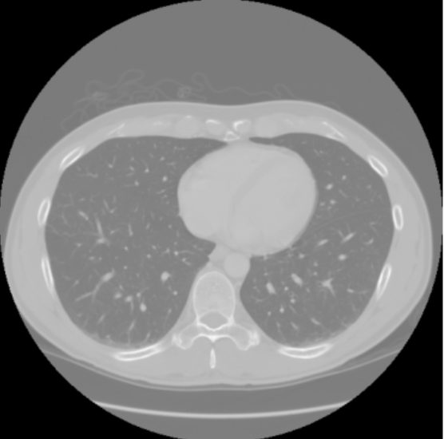
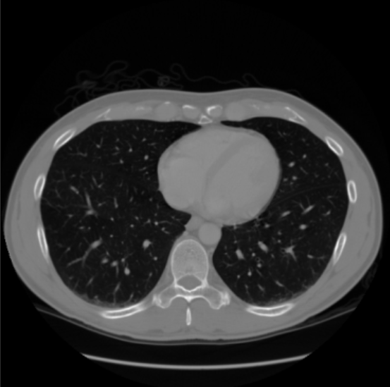
Conclusion
Rescale to (0, 255)
Patients who underwent resection for CRLM between 2003 and 2007
Only 45.5% patients were alive

Slide 13
Thank you

